Slide 1
Problem: ANN correction adds non zero-mean

Slide 2
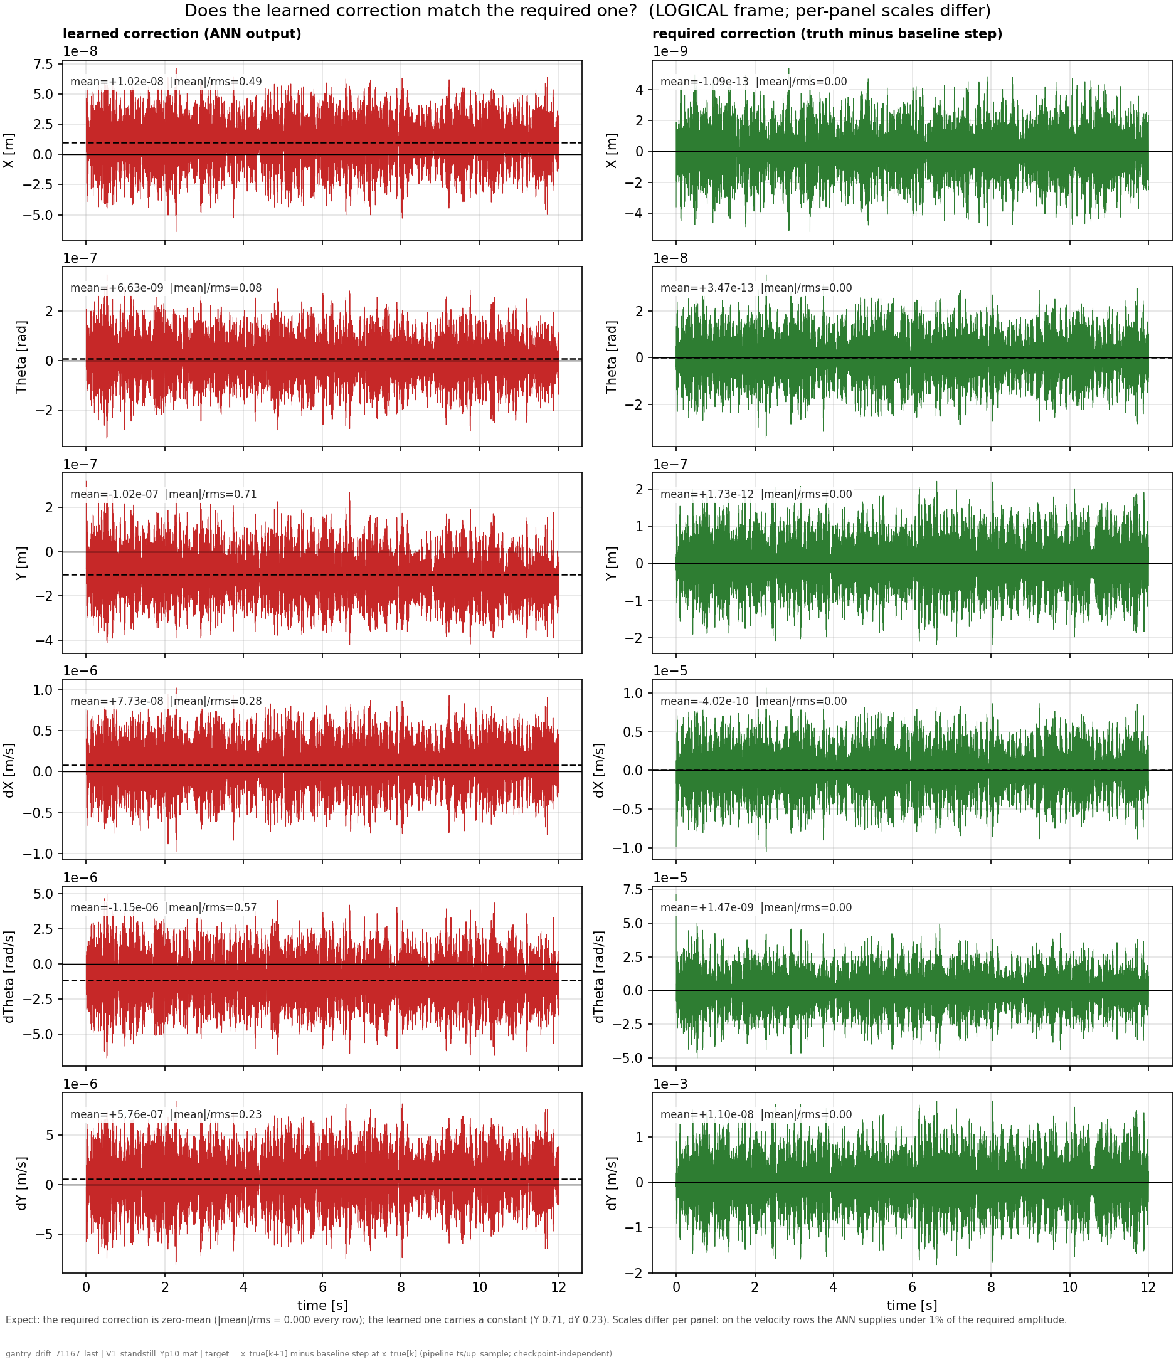
Compare ANN output against perfect correction
For reference:
  The correct correction for the ANN is zero-mean
Truth - baseline = zero-mean

Slide 3
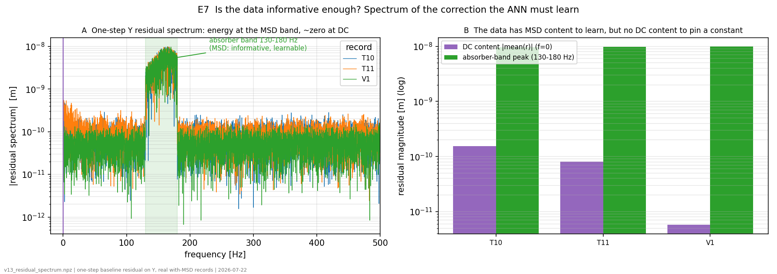
Is the data informative enough?

Slide 4
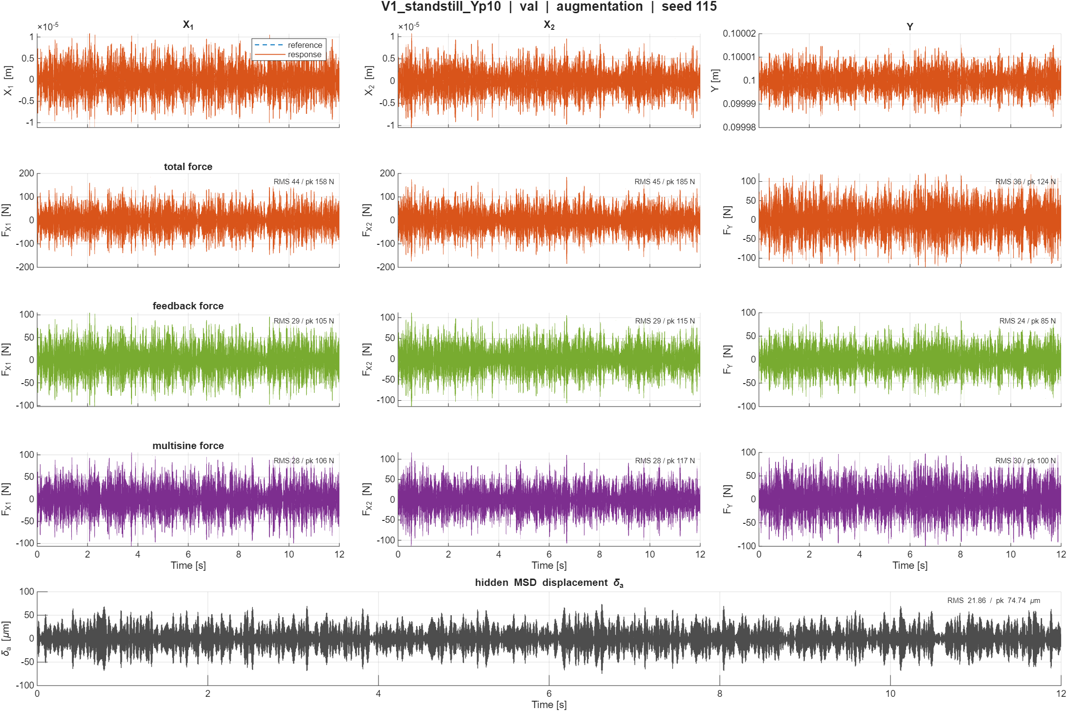
For context:
The data used for coming figures

Slide 5
To be discussed
Issue in the code creating the offset?
Training: flat landscape

Slide 6
Offset in the code
Does the code implementation cause an offset?
  Currently not found any issues in the code
Compare ANN output for baseline (without MSD) and compare against the system with MSD
Intentionally inject a known offset and see whether the ANN recovers this
  If we only see this behaviour for the injected offset and not in “offset free” baseline this would indicate it is not a code issue
Y and X are the states without stiffness (K=0)
  dY carries the dominant DC
    I also added single panels for dY to see it more clearly
  (The hidden absorber MSD is coupled to Y)

Slide 7
System == model:
  means the data was created in python with ANN-off
  “clean pipeline” also uses this data
Matlab no-MSD data:
  Simulink closed-loop run without the added MSD

Slide 8
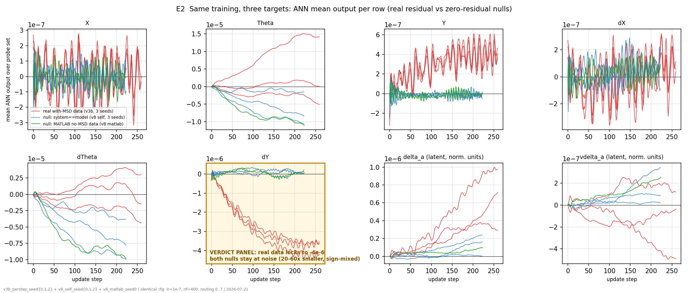
Identical training for all 3 methods. Need to look at the K=0 rows (X, Y, dX, dY): with the real absorber residual (red) the dY DC locks negative and grows to ~-4e-6.
The stiff Theta rows show that a constant forms in ALL 3, its output effect is bounded by the Theta stiffness and produces no drift.

Slide 9
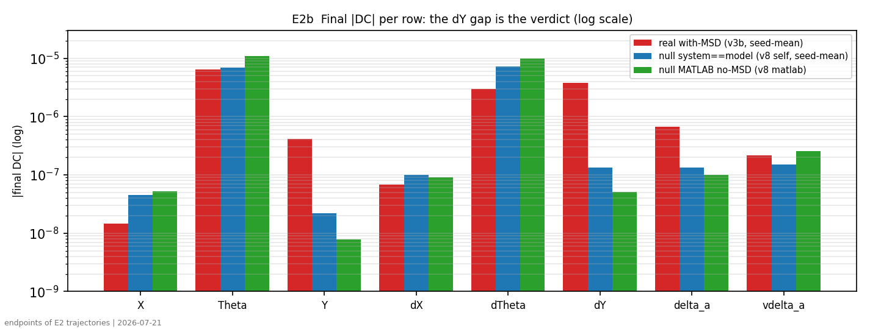
Y and dY stand out. But the added MSD is also added to the payload Y and the original payload mass is split over MSD and the new payload mass, 10 and 90 percent respectively. It should only affect the center of mass.
  But looking at the actual system (next page) the system is zero-mean, and the earlier image for the correct ANN (truth-baseline) also showed this

Slide 10
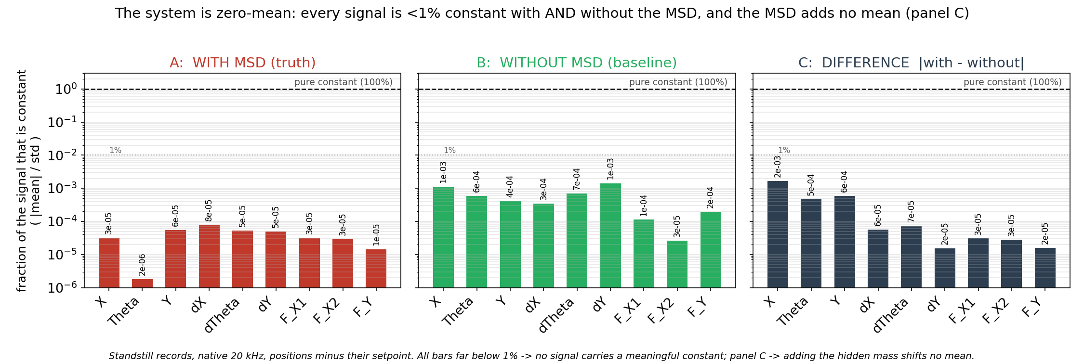
Note: minus the setpoint; NOT the signal’s own time-mean
Standstill operating points: T1_standstill_Ym30, T2_standstill_Ym15, T3_standstill_Y000, T4_standstill_Yp15, T5_standstill_Yp30

Slide 11


Slide 12


Slide 13
The Y seems to find a new offset point and not grow further but oscillate around the new point, but the system seems to be zero-mean. Unless minus set point is biased.
Question: If it’s a next state issue it should keep getting worse no?
  Since the Y is being scheduled each update step, so error keeps growing.

Slide 14
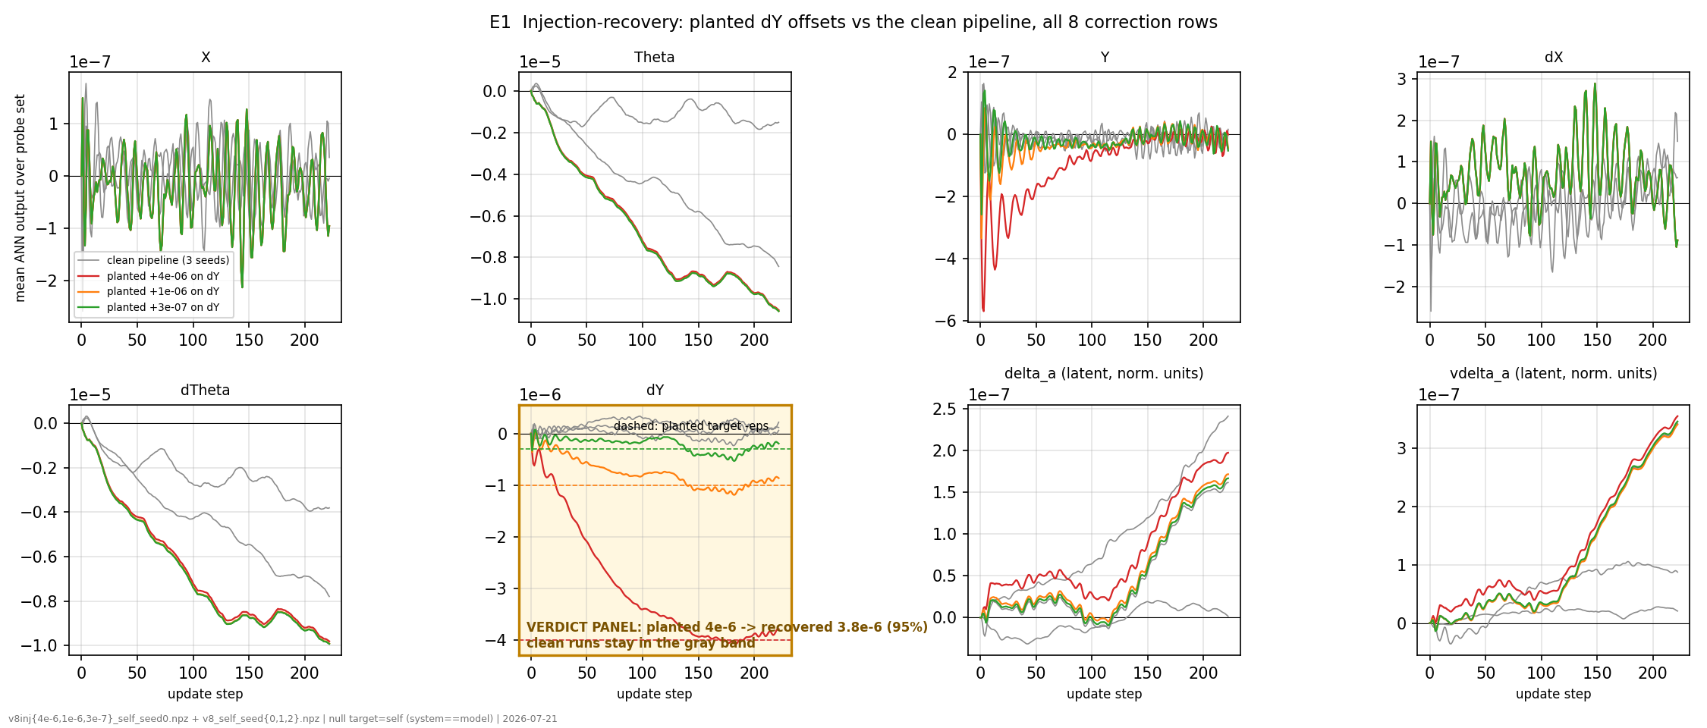
Inject a constant planted on the dY row
Every single timestep, +ε is added to the dY (Y-velocity) component of the model's state, on top of whatever the baseline and ANN computed. Nothing is added to the other 7 rows, nothing to the input u, nothing to the output y.

Slide 15
The dY row keeps growing, but Y gets back to 0.
  But with the MSD data mismatch with the model and we keep propagating the wrong Y.

Slide 16
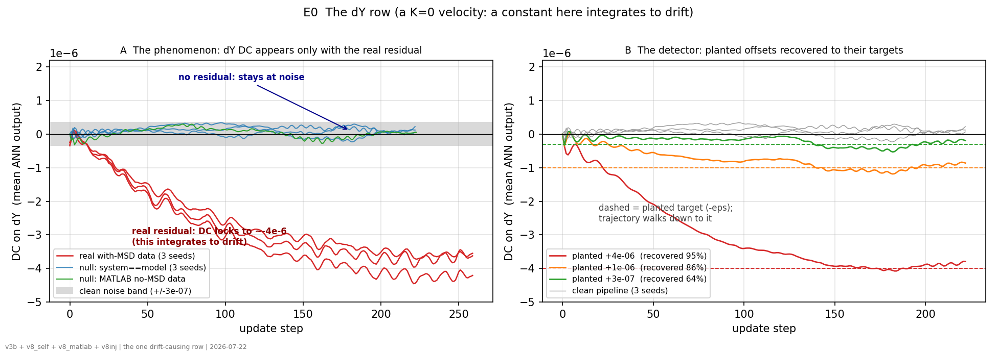
dY with K=0, for this velocity a constant integrates into position drift.
Left: the DC forms only when the real absorber residual is in the loss.
Right: planted offsets are recovered to their targets (95/86/64%), and the clean pipeline stays flat.

Slide 17
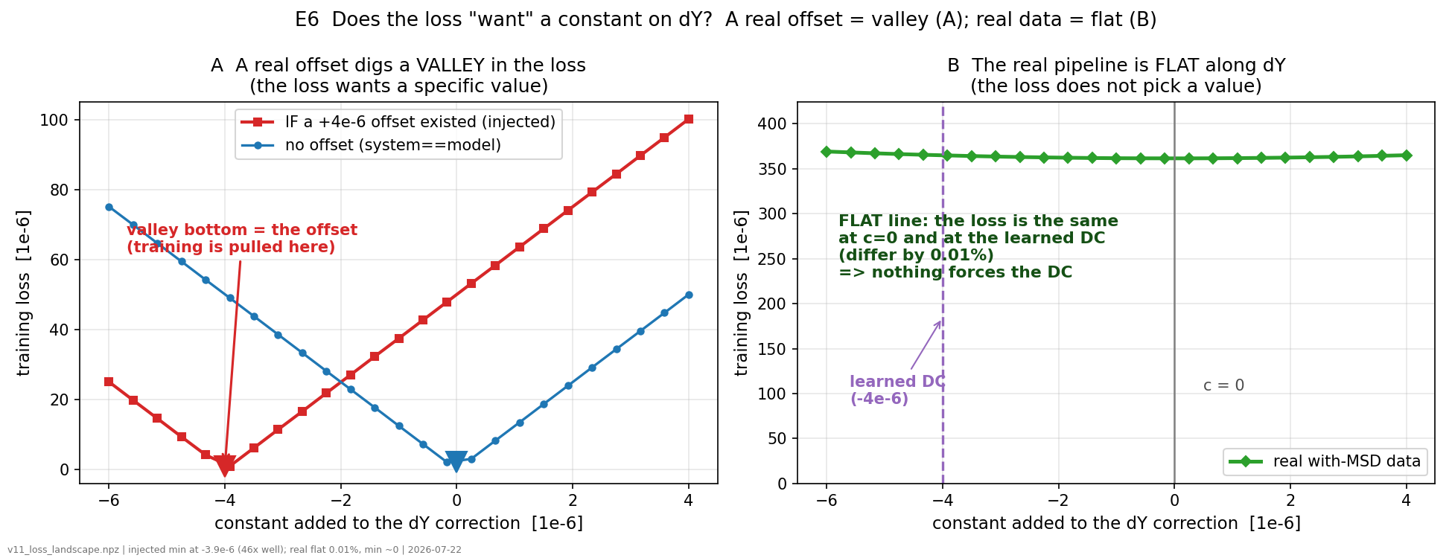
The loss landscape
Evaluation sweep, not training: no gradients and no optimizer.
We take the fixed baseline model and simply measure the loss for each candidate value of the constant.
Flat loss landscape, Adam is free to wander. The loss does not pin it.

Slide 18
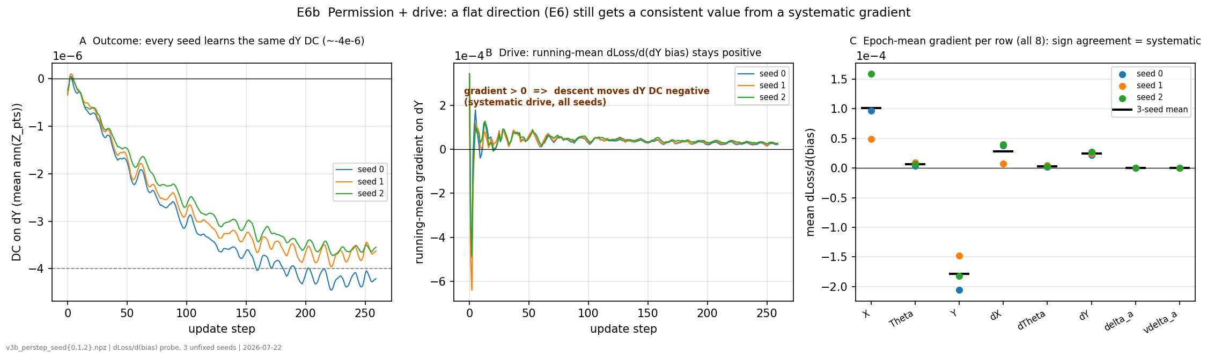
The behaviour is systematic.
Left: every seed learns the same dY DC.
Middle: the running-mean gradient on the dY constant stays positive in all seeds (a positive gradient drives the DC negative under descent), so the drive is systematic, not random.
Right: the epoch-mean gradient per row agrees in sign across seeds on the K=0 rows (dY especially)

Slide 19
Question: Systematic gradient caused by the truncated-BPTT bias? Increasing nf did not help.

Slide 20
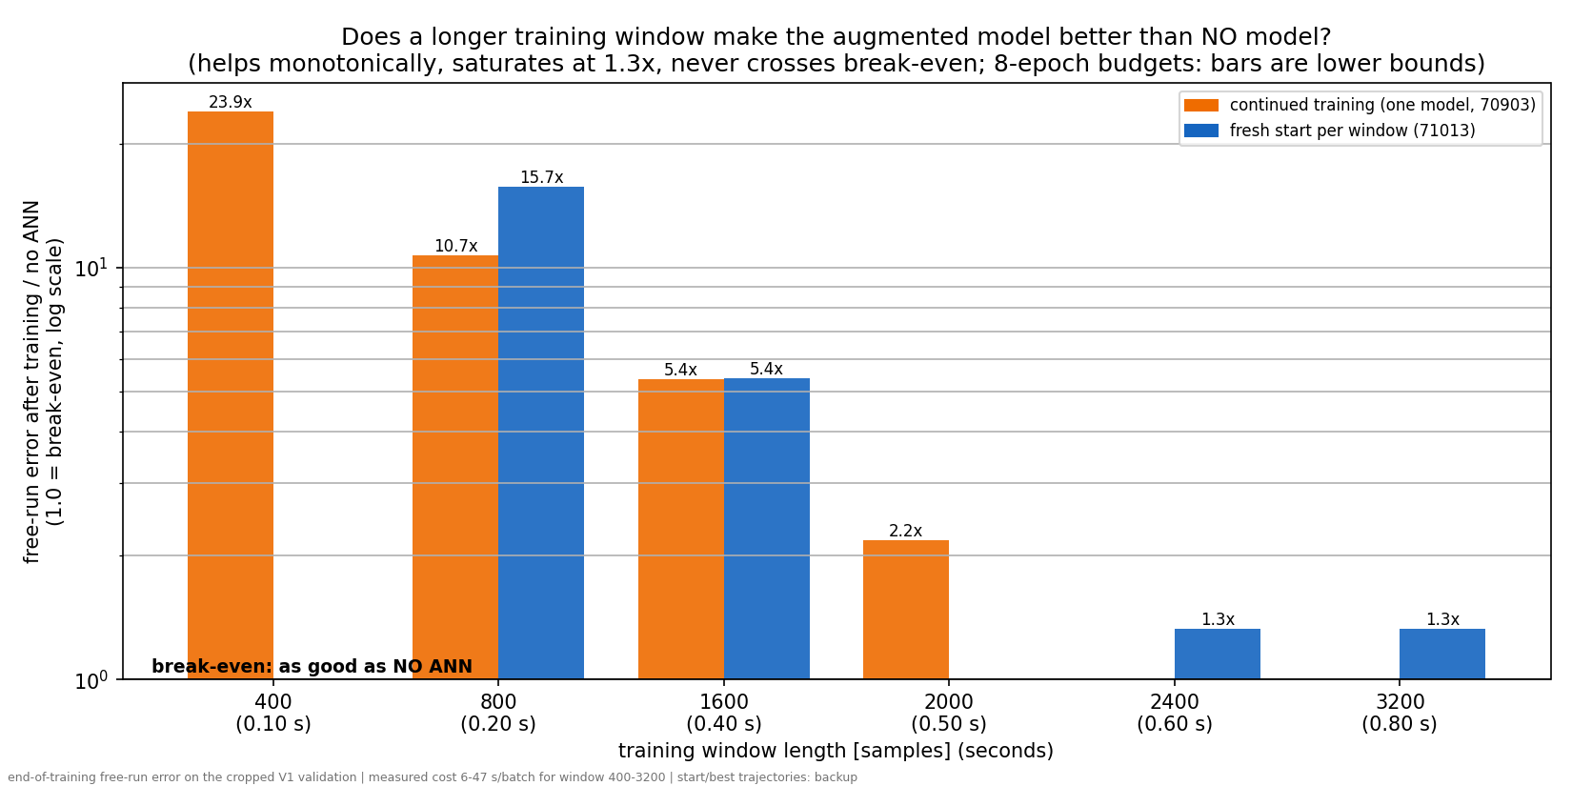
Hyperparameter search:
Learning rate and number of samples used for training (training window)
Conclusion: it is not a hyperparameter problem

Slide 21
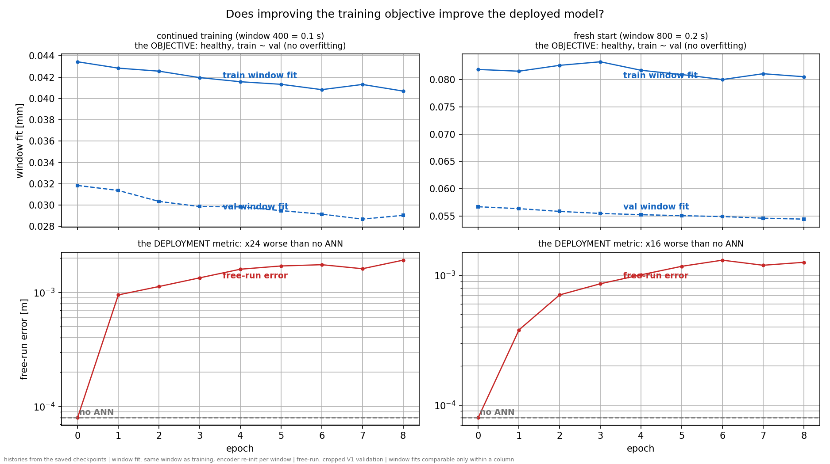
Look at train and validation loss for the training window
Why:
For validation we use sim-RMS, which is the full 12s validation open-loop free run and now 0.1 s

Slide 22
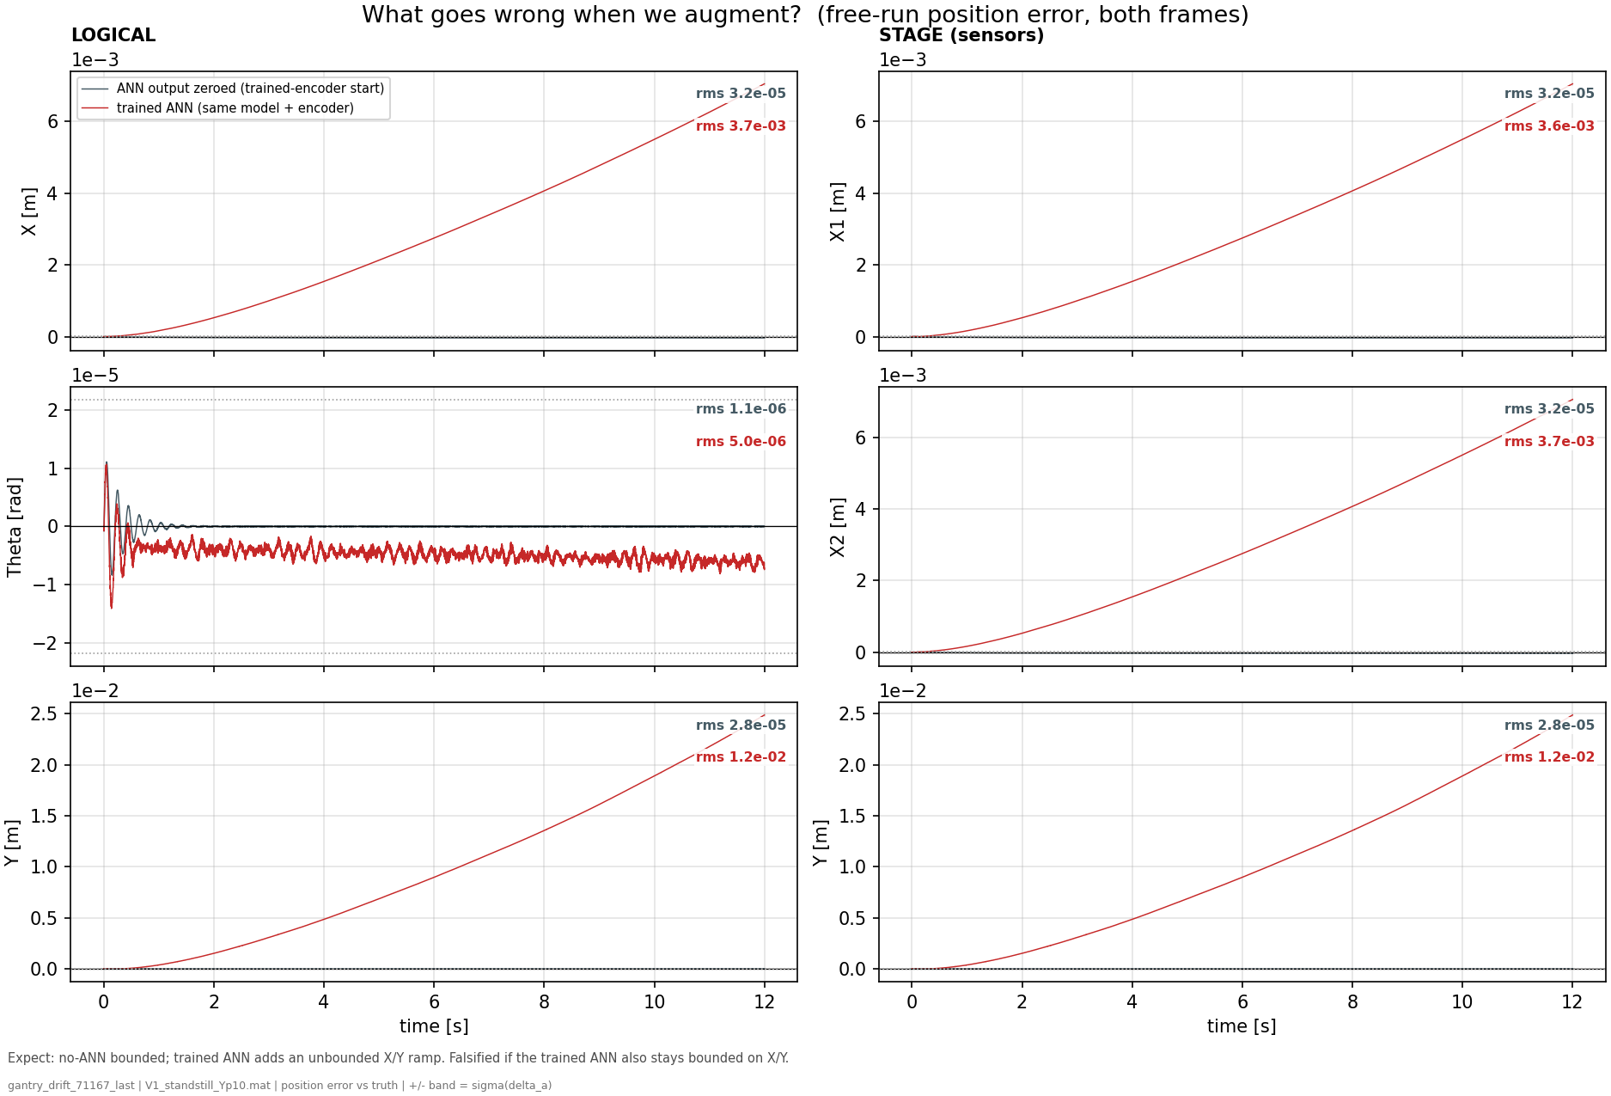
Take the derivative of the trained-ANN free-run
Position-error is the red line
Answer: is it an energy problem?

Slide 23
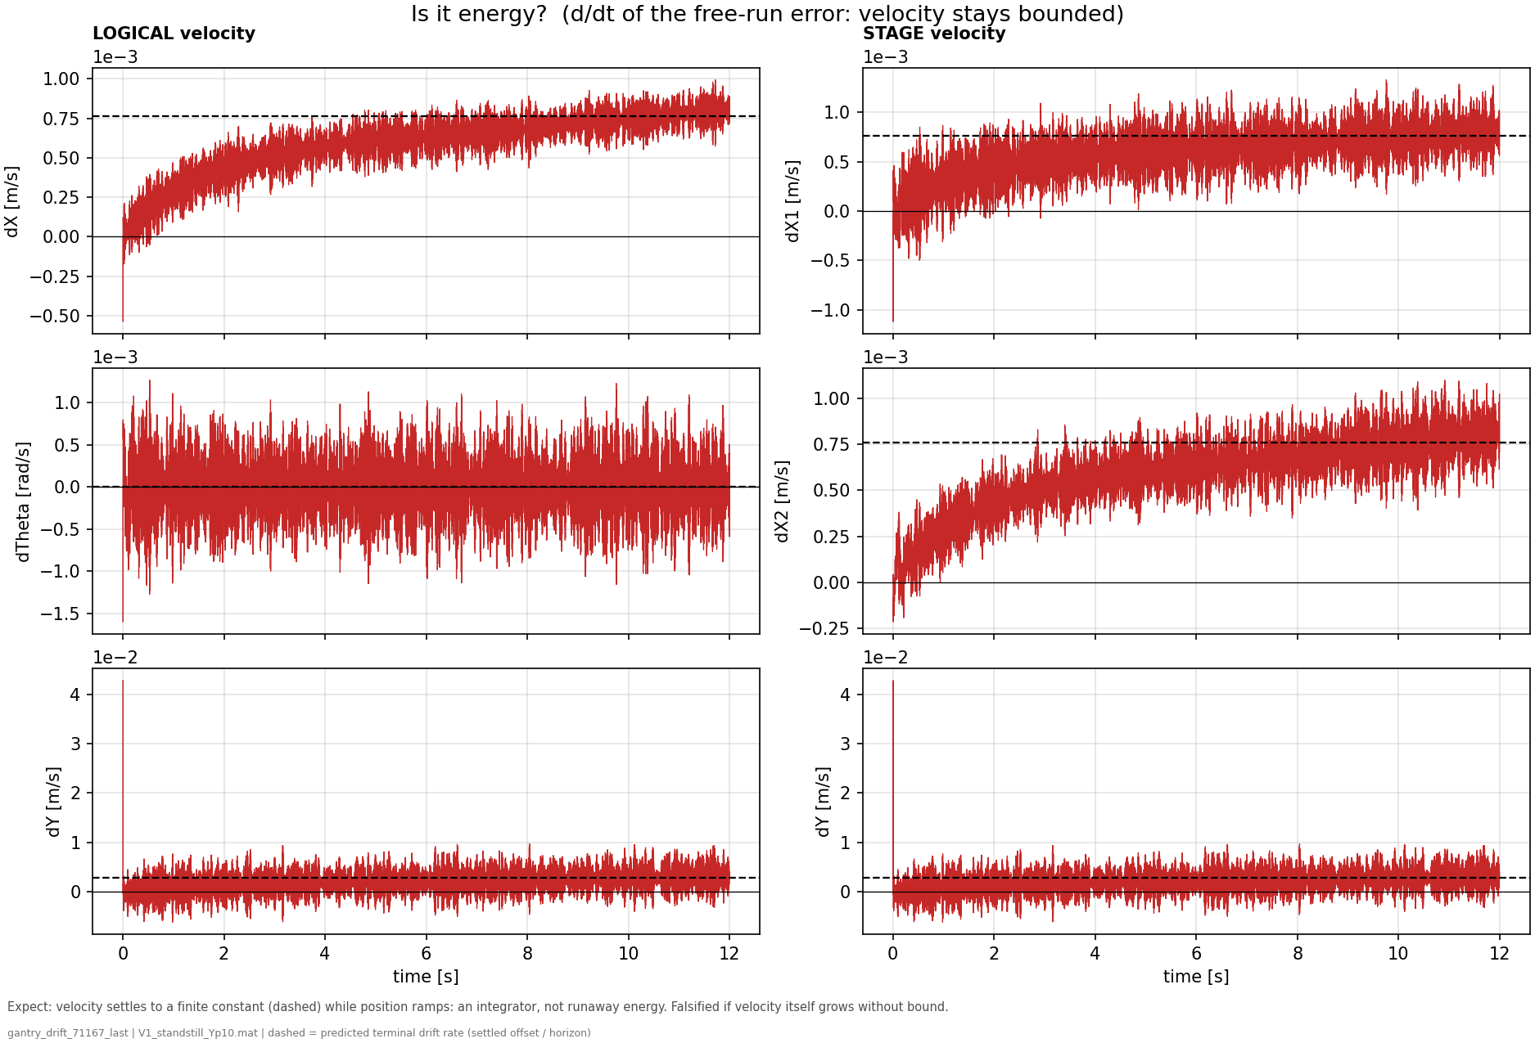
Conclusion:
Not an energy problem velocity seems to settle
Notes:
the trained-ANN free-run position error from f01 (the red drifting curves) and differentiate it in time
At t = 0 the free-run starts from the encoder's estimated state, not the true one. The estimate is good but not exact, and its velocity components are the weakest part:
f08 — is it energy? (d/dt of the drifting run's error)- Shows: the error velocity of the same trained-ANN free-run as f01, with the settled terminal rate dashed. (t = 0 spike = the encoder's initial velocity estimate error decaying with each axis's time constant — an IC transient, not drift.)- Hypothesis: if the drift were energy accumulation/instability, velocity (and kinetic energy) would grow without bound.- Conclusion: every velocity saturates at a finite terminal value while position ramps — the exact signature of a constant force balanced by damping. Energy is bounded (injection = dissipation); Jan's "no energy drift" intuition is confirmed, and an energy constraint targets nothing that is failing.

Slide 25
Mismatch system
Position offset
Data v1 standstill

Slide 26
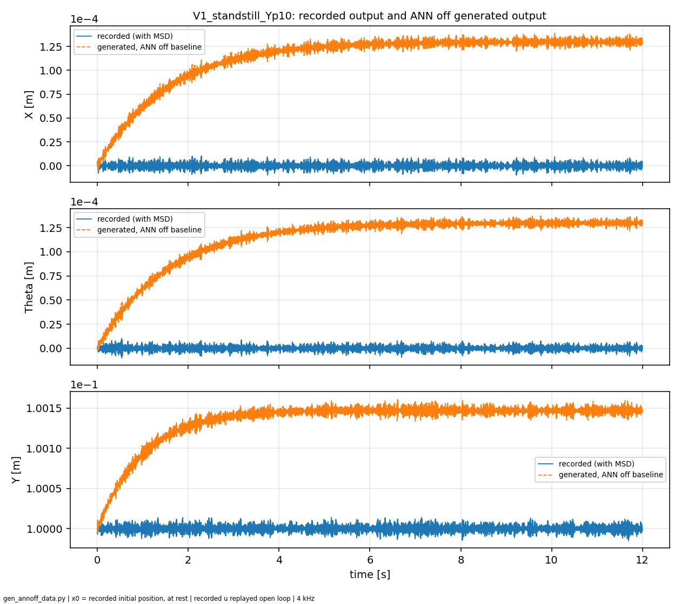
Mismatch model and data from system with MSD

Slide 27
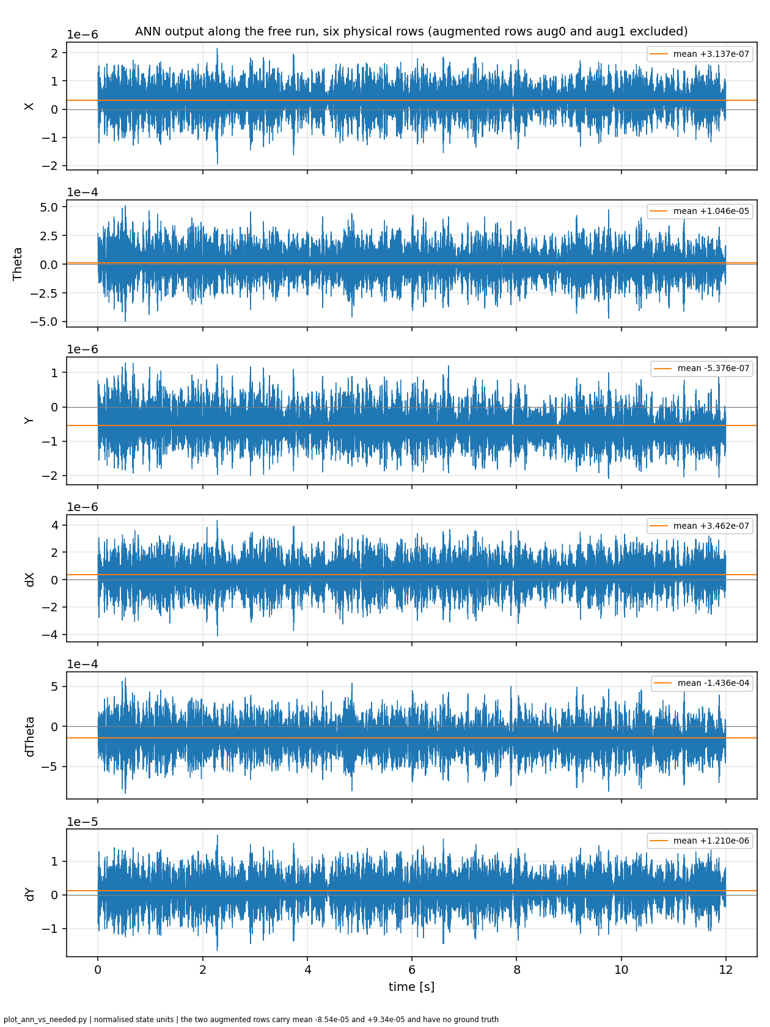

Slide 28
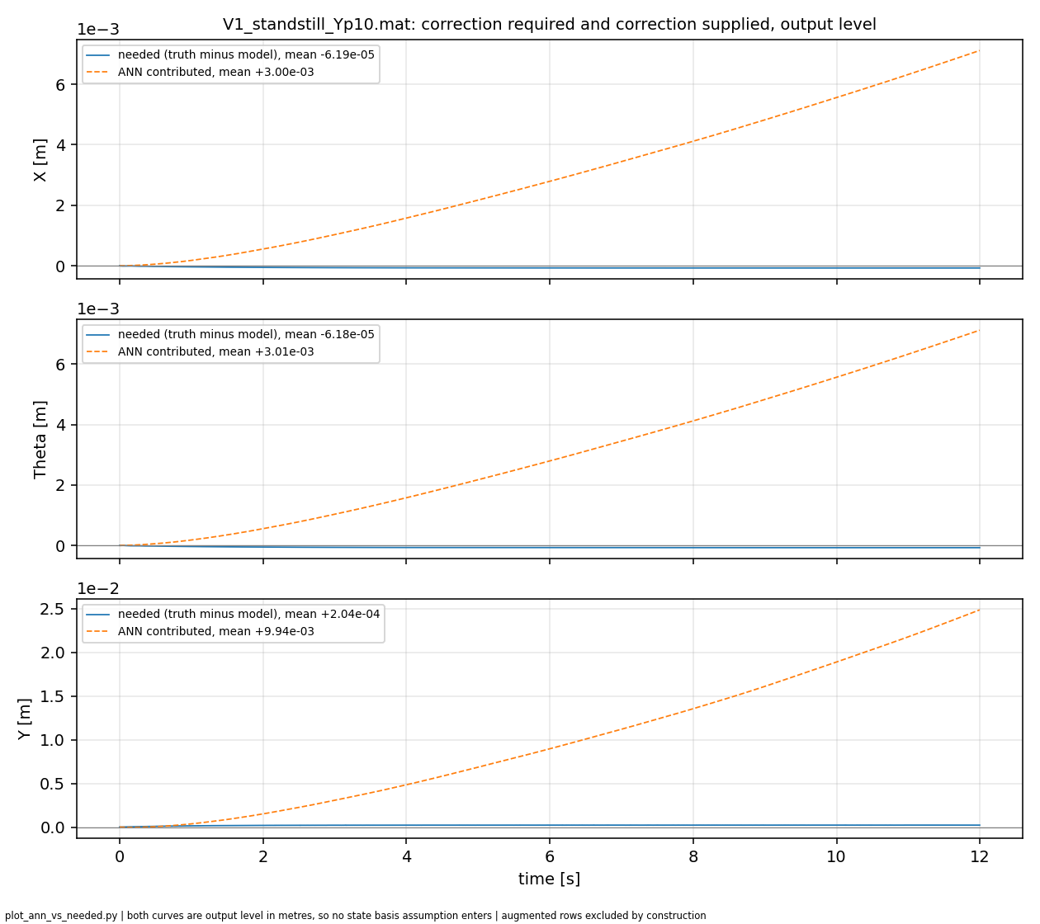

Slide 29
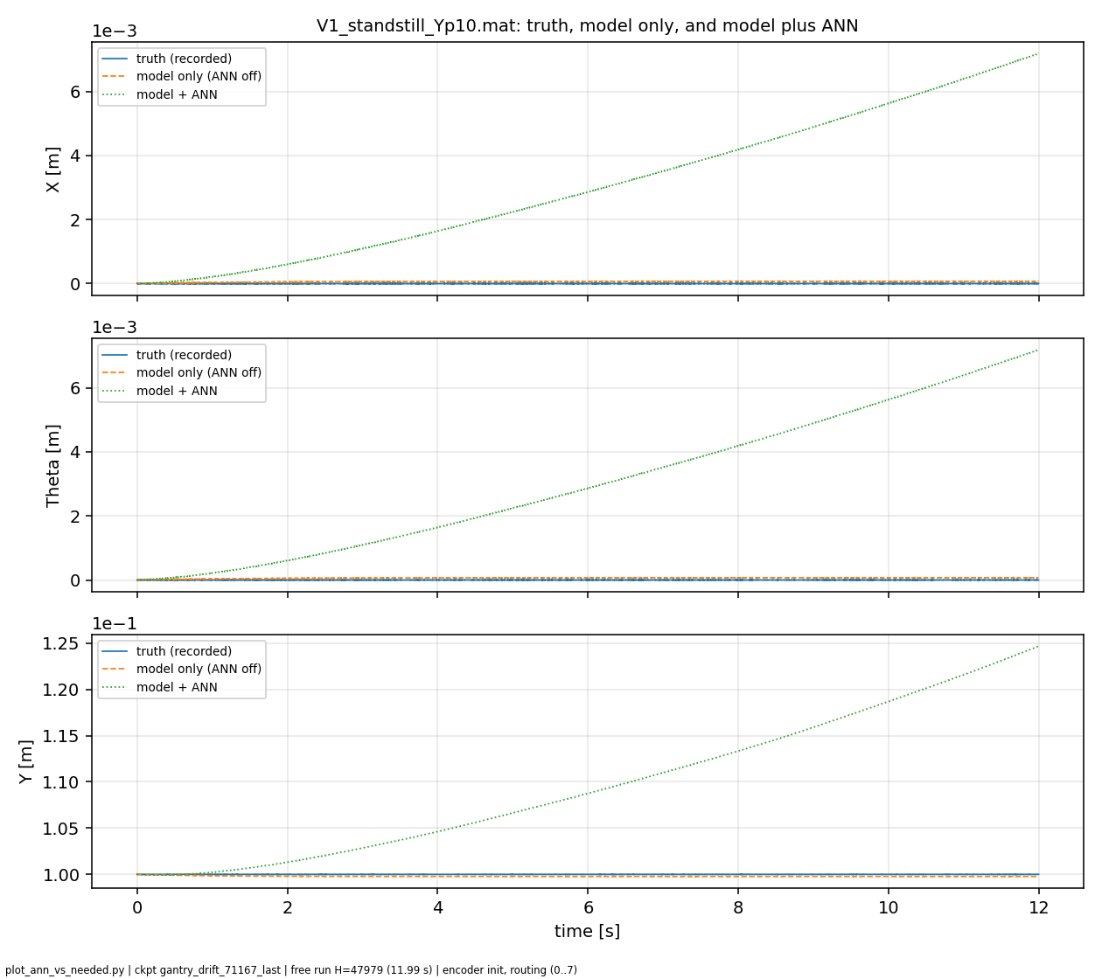

Slide 30
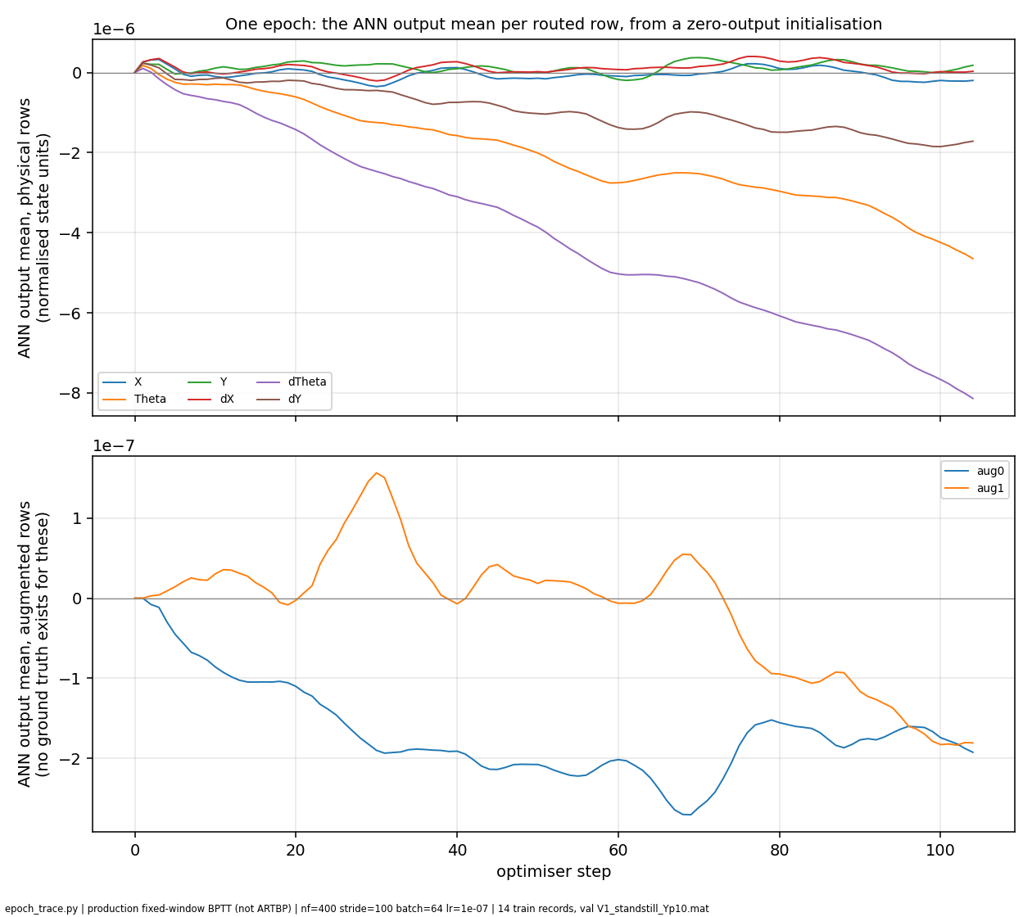

Slide 31
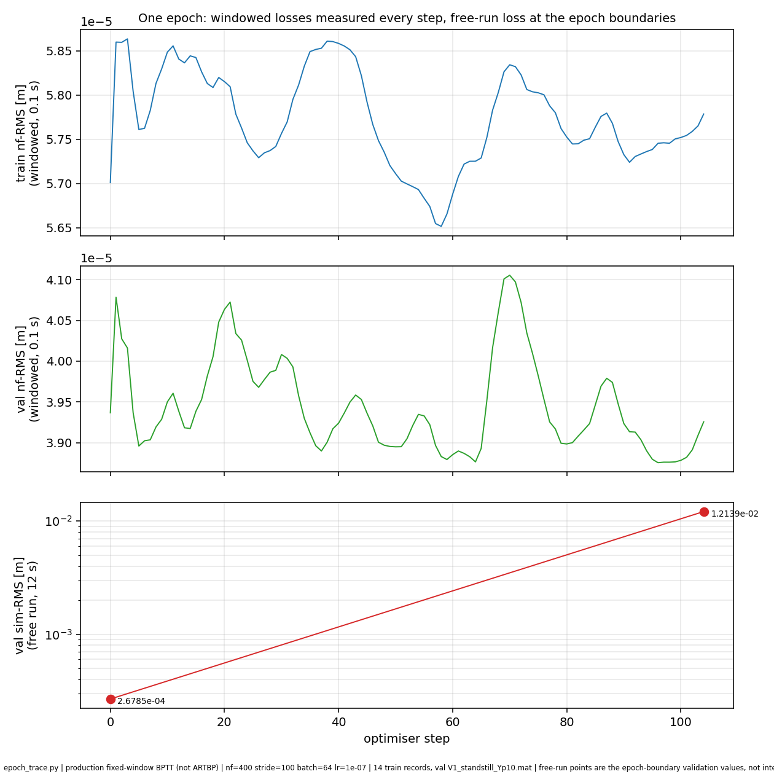

Slide 32
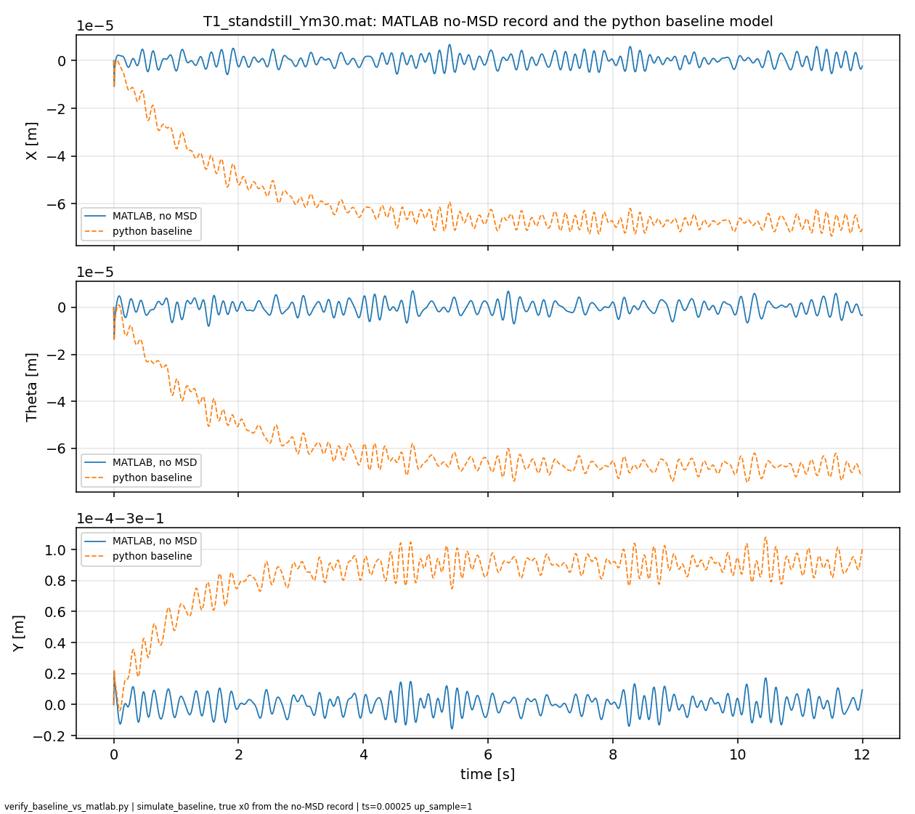
Model matches system
No MSD in the data

Slide 33
Model matches system
No MSD in the data
Note: this is with the ANN, but it has nothing to learn.
Was the offset identification wrong and maybe an issue with the model?
→ Next slide

Slide 34
Channel | Data Type | RMS Error [m] | Max |e| [m] | Final |e| [m]
X1 | float64 | 1.373 × 10⁻⁹ | 6.878 × 10⁻⁹ | 8.032 × 10⁻¹⁰
X1 | float32 | 1.244 × 10⁻⁹ | 6.867 × 10⁻⁹ | 3.724 × 10⁻¹⁰
X2 | float64 | 1.373 × 10⁻⁹ | 1.080 × 10⁻⁸ | 7.899 × 10⁻¹⁰
X2 | float32 | 1.249 × 10⁻⁹ | 1.080 × 10⁻⁸ | 3.353 × 10⁻¹⁰
Y | float64 | 1.068 × 10⁻⁸ | 4.137 × 10⁻⁸ | 3.665 × 10⁻¹⁰
Y | float32 | 7.435 × 10⁻⁷ | 1.732 × 10⁻⁶ | 1.732 × 10⁻⁶

Slide 35
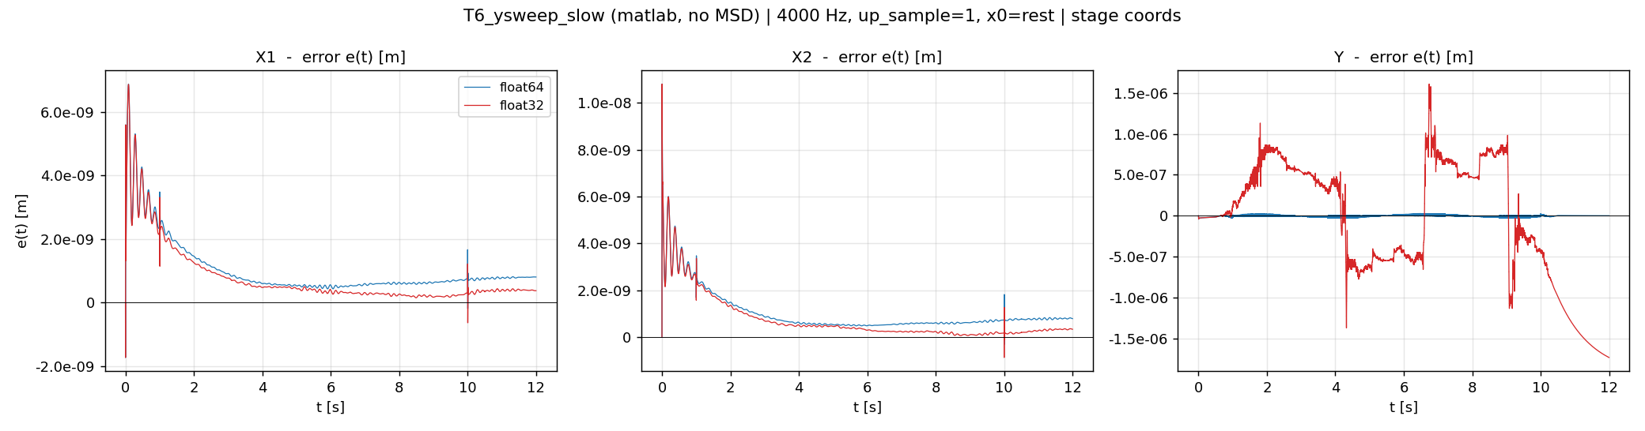
Not sure about the initial spike
  Could be due to downsampling from 20khz to 4khz

Slide 36
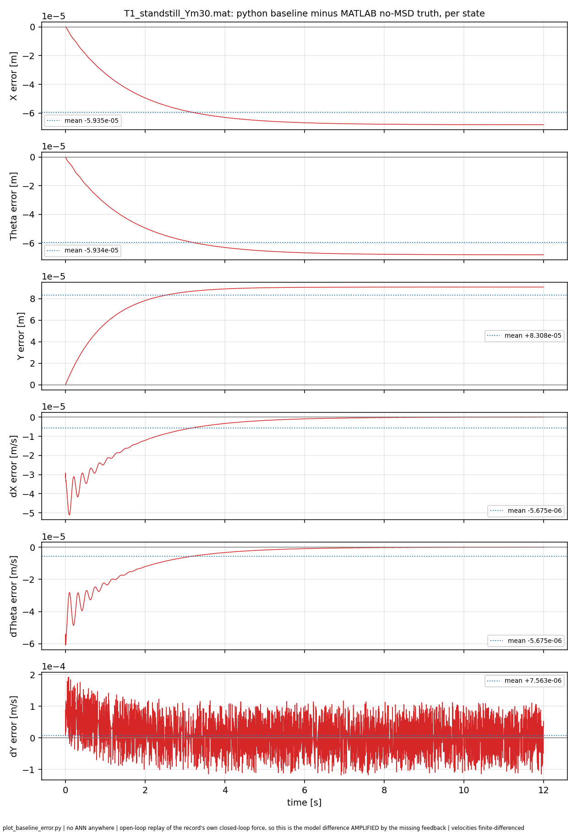

Slide 37
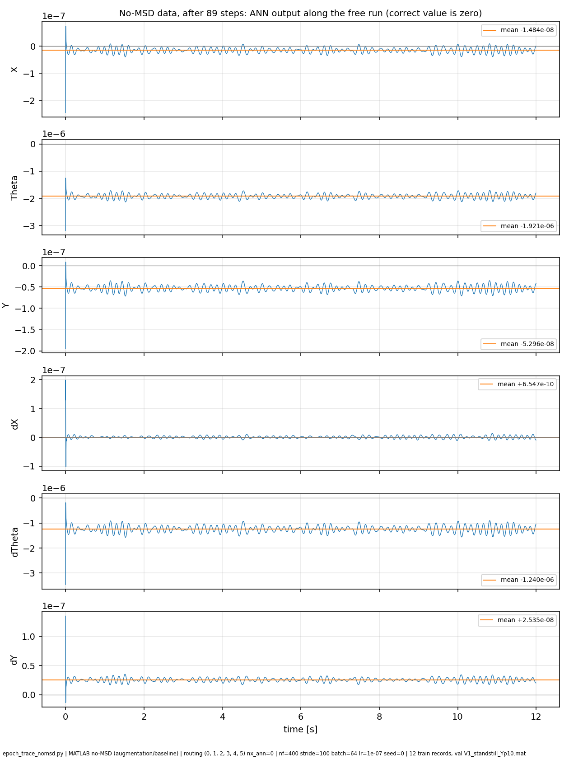

Slide 38
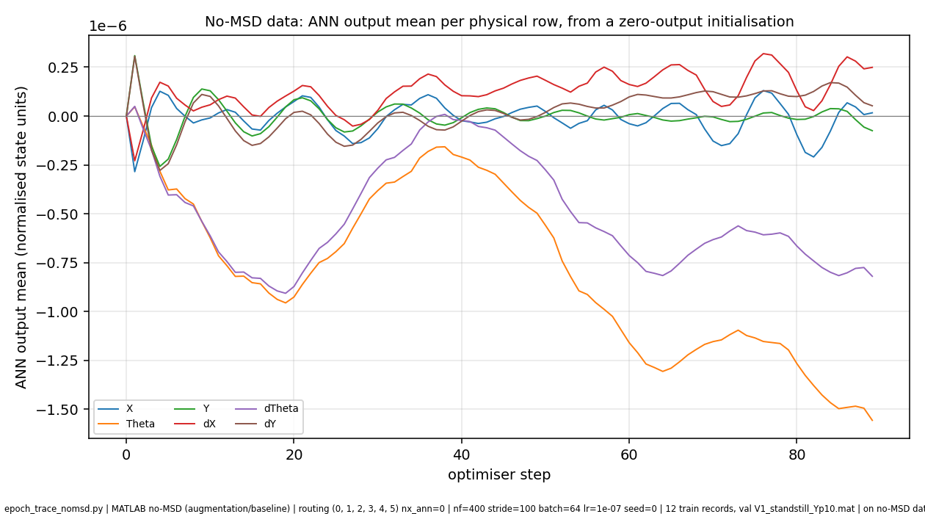

Slide 39
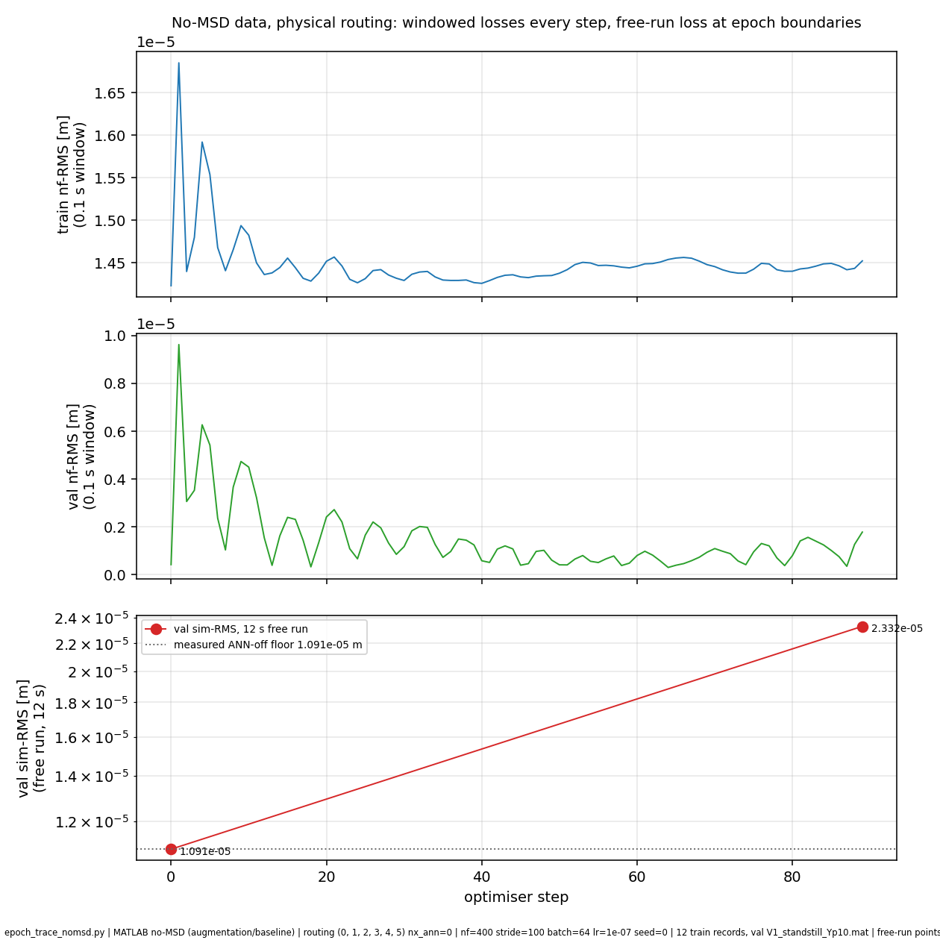

Slide 40
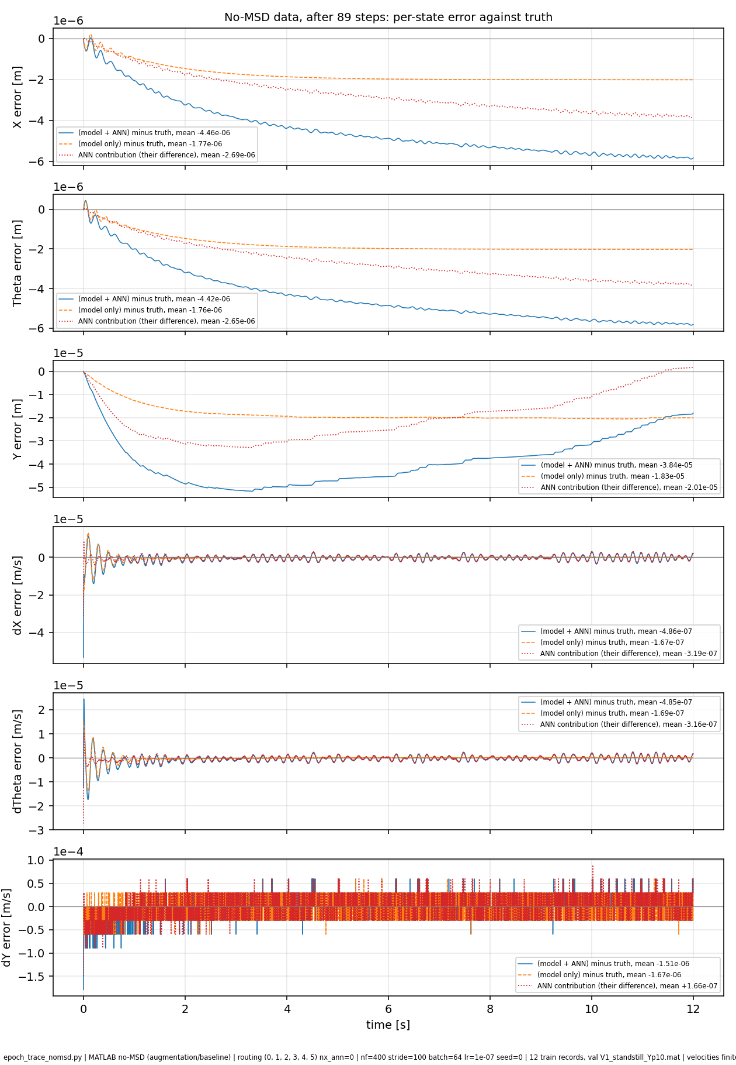

Slide 41
To do
Only black box training: pure ANN
Keep increasing nf till entire trajectory length
  Not realistic to run

Slide 42
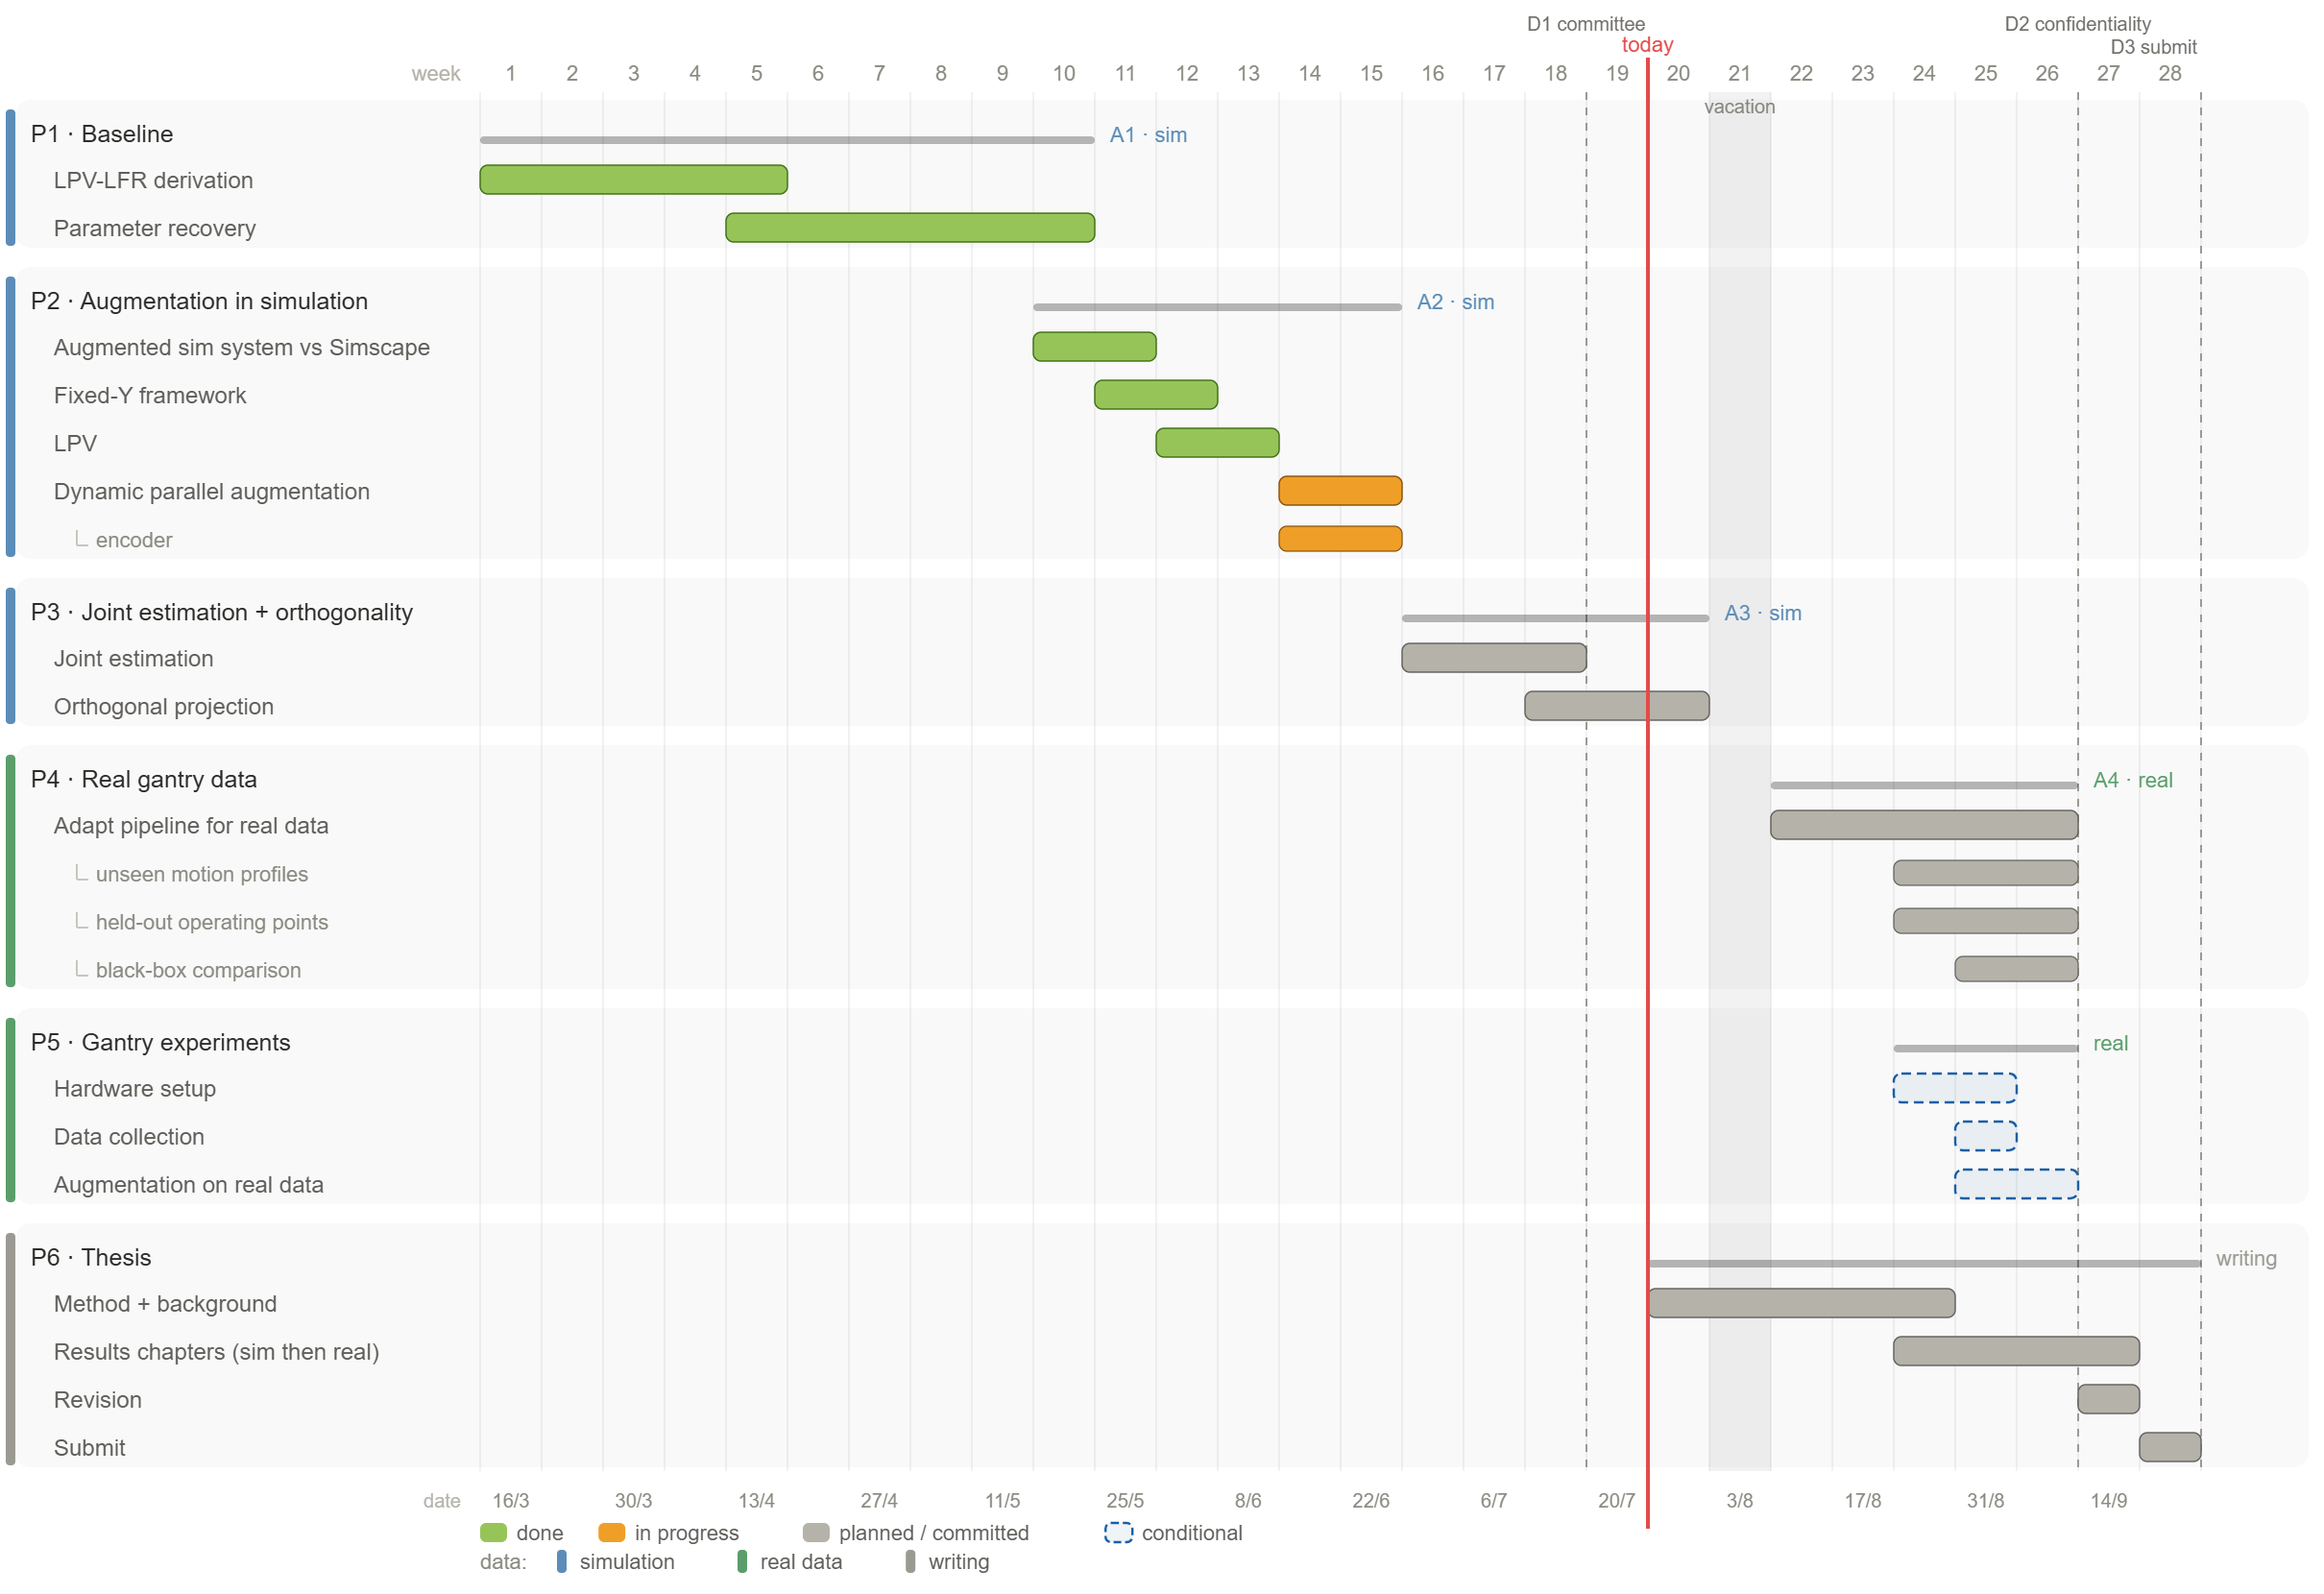

Slide 44
- Data: the MATLAB augmentation track, 14 train / 4 val / 4 test records, 12 s each, decimated 20 kHz to 4 kHz. The truth contains the hidden MSD absorber (ma_frac = 0.10, tuned 150 Hz); the physics baseline does not. Representing that absorber is the ANN's entire job.- Model: the 6-state LPV-LFR baseline plus 2 augmented latent states, so 8 states, with a static tanh ANN (2 hidden layers, 16 nodes, about 600 parameters) writing additive corrections to all 8 rows, and a SUBNET encoder (linear_map init, na = nb = 17) setting the initial state from past inputs and outputs.- Training: windowed simulation error, nf = 400 steps = 0.1 s windows, batch 256, Adam lr = 1e-7, 20 epochs = 5200 updates, seed 42, up_sample = 1.- Selection: best checkpoint on the 12 s free-run validation RMS. argmin came out 0.- Outcome: 1.661e-04 m at epoch 0, 2.109e-02 after one epoch, 1.951e-02 at epoch 20, while the 0.1 s validation error falls 14 percent.Two settings worth knowing, because they define what this run does and does not test: joint_estimation = False, so the physical parameters are frozen and only the ANN and encoder train; and orth_beta = 0 with orth_observe = True, so the orthogonal projection penalty is off and merely observed. That means the run our entire diagnosis rests on does not exercise the thesis's actual contribution at all. It is the clean augmentation-training experiment, which is why it is the right one for the deck, but it is worth stating out loud in the meeting.

Slide 46
Previous question: why does Adam put a constant in a direction the loss does not constrain".
That framing is dead, because the loss does constrain it and measurably prefers it removed.

Slide 49
One thing that was not already nailed: a direct, exactly-verified measurement that the constant output-DC direction is stiff, not flat. That legitimately removes the DC-pin option (it targets a direction the loss already over-constrains) and it puts pressure on the zero-mean "loss-flat DC direction" language (that was inferred from SGD-vs-Adam, not measured). That's the one option this test eliminated. It did not change the destination.

Slide 50
Your two normalizations are already tied: model.py builds the encoder matrices with normalize_linear_ss_matrices(..., sys_data_with_x) where sys_data_with_x.x = norm.x_all, i.e. the same array that defines x_mean/std_x for the rollout (that is what D-119 fixed). So std_x/x_mean is one frame, not two.The mismatch is one level below that. gantry_linearize_and_discretize is hard-coded to Y_op = 0.0 and raises NotImplementedError for anything else, so the encoder's reconstructability map is LTI at Y = 0. The rollout is the nonlinear LPV block with M(Y) self-scheduled on x[2]. Your training set sits at Y = -30, -15, 0, +15, +30 mm plus ysweeps over roughly ±0.3 m.

Slide 51
The ANN's target is the absorber force. Over a 0.1 s training window that force's position consequence is below the loss's resolution — drift-visual/f09 puts the drift contribution at 0.79x the floor at 0.1 s and 784x at 12 s.

Slide 52
The problem is not the window length. It is that the windows are independent. Every window is re-anchored to measured data at its start, so no window is ever held responsible for the state it hands to the next one. The objective is a sum of decoupled short problems, and lengthening them does not change that structure — it just makes each decoupled problem longer. That is why the nf sweeps failed: the DC only falls as 1/nf, so you would need an absurd horizon, and meanwhile the gradient through a marginal mode degrades as O(N^3) (Ribeiro Thm 1 at L_h = 1), which is exactly the NF=900 divergence.

Slide 53
❯ you got this from a paper right?Yes — but via a repo document, not from my own reading, and that distinction matters here.The source is docs/multiple-shooting-sweep-2026-07-25.md, a deep-research sweep run by an earlier session yesterday. Four papers carry it:- Ribeiro, Tiels, Umenberger, Schön, Aguirre, On the smoothness of nonlinear system identification, Automatica 121:109158, 2020 (arXiv:1905.00820) — Thm 2 / Cor 3 (equivalence holds iff defects vanish, regardless of segment length) and Thm 1 (O(N^3) beta-smoothness at L_h = 1).- Turan & Jäschke, IEEE L-CSS 6:1897-1902, 2022 (arXiv:2109.06786) — the penalty form, and the exact-penalty property of the non-squared norms.- Beintema, Tóth, Schoukens, L4DC/PMLR 144, 2021 (arXiv:2012.07697) — the finding that SUBNET is multiple shooting with the encoder as node elimination.- Fisher et al., ECMWF weak-constraint 4D-Var, 2011 — Q^-1 as the principled defect weight.

Slide 54
so where are we now. i feel we have tried EVERYTHING :(Not everything — and today is actually the first day this project got a mechanism instead of another failed candidate. Let me lay it out plainly.What today established, none of which was known this morning:- The failure is now precisely characterised (MS5, read off your own production run): train loss -19%, train windowed -13%, val windowed -14% — all improving — while 12 s free-run degrades 127x at epoch 1. The validation-windowed number is the load-bearing one: it rules out overfitting. Same data, same model, better at 0.1 s, 127x worse at 12 s. It is purely horizon.- The encoder is not the mechanism (MS2): it settles to a bounded offset, late slope collapses 92x from 2 s to 12 s.- But the encoder is badly built (MS1): error scales with |Y| at corr = +0.995 because the reconstructability map is LTI at Y_op = 0. That's concrete and fixable, and it explains why diag20's na sweep never found a trend.- And the defect is blind, with a reason (MS6): the failure is narrowband at DC; the defect is a broadband RMS. Averaging over the spectrum destroys the component that matters.That last point is bigger than one dead candidate. Look at what drift-conclusions §4 already ruled out: longer nf, ARTBP and unbiased truncation, preconditioning, lr tuning, Adam→SGD. Every one of those is a broadband intervention aimed at a narrowband failure. Today's result is a single explanation for why the entire campaign's candidate list failed — they were all aimed at the wrong part of the spectrum. That's not a dead end, it's the first unifying diagnosis this project has had.And it converges on your actual contribution. The thing that survives is a term that selects the DC component specifically. That is the orthogonal projection, re-aimed — which is the thesis's scientific contribution, now with a measured justification instead of an assumed one.One concrete next step, and it's cheap. Penalise the running sum of defects across boundaries rather than each one's RMS. The reason it should work is derivable: if each defect is DC + ripple, then summing over n boundaries gives n·DC + O(√n)·ripple — the DC adds coherently, the ripple averages down, so SNR improves as √n. MS6's own data predicts a large ratio where RMS gave 1.01x.It's a few lines on the implementation that already passes 5/5 method tests, and I can test the prediction in the MS6 harness — no training — before anything expensive. If the ratio jumps, we have a live term. If it stays at 1x, we've learned the DC isn't coherent across boundaries, which is itself decisive.Want me to run that?

Slide 55
Decisive. Both tests agree, and the α-sweep confirms we're in the linear regime this time.Test B — twin perturbation (drift cancels exactly, isolates the propagator)┌──────────┬──────┬────────┬────────────────┬────────────────┐│ arm │ α │ growth │ poly-exp (R²) │ exp-rate (R²) │├──────────┼──────┼────────┼────────────────┼────────────────┤│ INIT │ 1e-6 │ 4.85x │ +0.342 (0.930) │ +0.078 (0.586) │├──────────┼──────┼────────┼────────────────┼────────────────┤│ INIT │ 1e-5 │ 4.32x │ +0.336 (0.874) │ +0.072 (0.476) │├──────────┼──────┼────────┼────────────────┼────────────────┤│ DEGRADED │ 1e-6 │ 6.28x │ +0.422 (0.961) │ +0.104 (0.693) │├──────────┼──────┼────────┼────────────────┼────────────────┤│ DEGRADED │ 1e-5 │ 5.92x │ +0.415 (0.952) │ +0.099 (0.656) │└──────────┴──────┴────────┴────────────────┴────────────────┘Polynomial in every case — R² 0.87–0.96 for the power law against 0.48–0.69 for exponential. The exponent is sub-linear (~0.34–0.42): perturbations grow slower than linearly, which is a marginal system with damping, not an instability. The exponent is α-invariant (0.342 vs 0.336; 0.422 vs 0.415), so Orrell's step (c) passes and we are in the linear regime — unlike MS10.The INIT arm is the control that matters: its ANN output is identically zero, so it has no ANN-induced dynamics at all, and it still grows 4.85x. The degraded model adds only 1.29x on top of that.Test B refutes reading 6.2. There is no diverging mode.Test A — shape from e(0) = 0 exactly┌──────────┬─────┬───────────┬────────────────┐│ arm │ row │ final |e| │ poly-exp (R²) │├──────────┼─────┼───────────┼────────────────┤│ INIT │ X │ 9.94e-05 │ +0.479 (0.809) │├──────────┼─────┼───────────┼────────────────┤│ DEGRADED │ X │ 2.192e-01 │ +1.484 (0.997) │├──────────┼─────┼───────────┼────────────────┤│ DEGRADED │ Y │ 1.295e-01 │ +1.677 (0.931) │└──────────┴─────┴───────────┴────────────────┘R² = 0.997 on the X row is an exceptionally clean power law. An exponent between 1 and 2 is exactly the signature of a constant force on a lightly damped axis: t²/2 early, transitioning toward t·f·τ late, with τ_X = 1.546 s over a 12 s window. And it's 2200x the init's. Verdict: reading 5 (accumulated tendency / constant force error) is confirmed; reading 6.2 (slowly diverging mode) is refuted. That resolves the question I flagged as the most serious unexcluded alternative, and it settles the fix family: DC-selective and bias-aware routes are the right direction, and the anti-damping/stabilisation family is not needed.One correction to my own script: its auto-verdict printed "mixed / inconclusive" because I coded a crude absolute threshold (growth < 2x) instead of comparing arms. The measurement is clean; the verdict logic was too blunt. Caveats ngle seed, and Test A's reference is MATLAB's truth rather than thePython model's own state.Let me log this.

Slide 56
Replacing the entire trained ANN with eight constants reproduces the whole failure — slightly overshoots it. The network's state-dependent behaviour contributes essentially nothing to the 12 s error. Removing just the mean cuts the error 2.7x.

Slide 57
That run — baseline-null/curvature_sensitivity.py, 2026-07-24 — pre-registered my link 3 as its hypothesis, verbatim: "the windowed loss is BLIND/FLAT on the marginal (K=0) integrator output-DC... so 0 is a non-restoring valley the optimizer walks -> drift". Outcome: REFUTED. The windowed loss is STIFFEST, not flattest, on that direction — d²L/db² = 7.084e4 on X, 3.542e4 on Y, positive-definite Hessian, autograd matching finite difference.

Slide 58
A4: ystd ratio 5.88. Y is normalised by 1.90e-01 against X's 3.23e-02. The training loss divides by these; the selector doesn't. So Y errors are down-weighted 5.9x in amplitude, 34x in squared error, relative to the metric that judges them.

Slide 59
Both decisive, and together they produce something new.A3: ratio 2.27e12. My objection doesn't just stand, it's overwhelming — adjoint weighting for a long-horizon position functional weights DC 2.3 trillion times more than 150 Hz. That wouldn't trade G2 for G1, it would forbid learning the absorber outright.A4: ystd ratio 5.88. Y is normalised by 1.90e-01 against X's 3.23e-02. The training loss divides by these; the selector doesn't. So Y errors are down-weighted 5.9x in amplitude, 34x in squared error, relative to the metric that judges them.And A1 found the systematic drift is on Y and dY specifically. The axis the loss under-weights 34x is the axis that acquires a systematic DC. Let me chase that immediately.

Slide 60
Conclusion of sunday
You're right to push, and I over-concluded. Let me correct it.The production record contradicts non-convergence, and I should have applied that immediately. MS5's dose-response is the killer: 130 batches → 9.5x, 5200 batches → 127x. The failure grows with optimiser steps. A transient that converges away does the opposite. Add to that: 10 independent checkpoints all carry a DC; SLURM 71013 swept nf 800–3200 and found it on all 9; the curriculum run warm-started through 4 rungs and never beat epoch 0. More steps have never once helped.So no — I do not think this is an epoch issue, and I shouldn't have presented it as the leading explanation an hour ago.Where A9 misled me. It showed a descent direction exists at one point, over 12 steps, on 12 windows of V1, using normalised gradients on a different objective (Σ mean²) than the training loss. That is a local existence claim. It says nothing about where Adam goes on the real objective across 6664 training windows — and the 5200-step record says Adam demonstrably doesn't go there. A7 has the same weakness: 40 windows of one training record against a 6664-window bank.I'm leaving B0 running because it's a real test and I've pre-declared the readings, but I now expect it to refute my own hypothesis — mean flat or rising. If so, that's branch three: the descent direction exists and Adam won't follow it, which points at the optimiser rather than the objective.On whether the day was worth anything. The honest ledger: the failure is now precisely characterised — accumulated constant force, 17–23 mN, eight constants reproducing 112.8% of it, with a clean R² = 0.997 signature. That's real and it wasn't known this morning. What I do not have is a working fix, and five candidate mechanisms have been killed, three of them mine.That's genuine progress by elimination, not a solved problem. I'd rather say that plainly than hand you a false resolution — and "just train longer" would have been exactly that.

Slide 61
Adding values to the K=0 X and Y
Your test answers its question, and the answer is: K=0 is purely an amplifier.At ωn = 1 Hz the ANN's output is an almost perfect constant — purity 0.998, the most DC-dominated arm in the sweep — and yet the free run is only 1.059x ANN-off. The network still acquires the DC; with a spring it simply no longer integrates. By 10 Hz the free ratio is 0.998, i.e. the ANN does no harm at all.So adding stiffness would make the symptom disappear while leaving the cause untouched. That distinction matters for the thesis: it means the drift is not evidence of a learning pathology specific to marginal plants — the pathology is there either way, and marginality is what converts it into a 127x deployment failure.

Slide 62
Overview diagnostics
diagnostic-overview.md

Slide 63
Removing the mean improves?
What is solid either way, and is the real result: MEAN-REMOVED lands at 0.87-1.26x the init on all three arms, against FULL at 19-35x. Removing the DC recovers essentially the entire loss. Whether it ends slightly under or slightly over the init is the part still open.

